Slide 1
ADHD “Attention Deficit Hyperactivity Disorder”
Psychoeducation and skills group

Slide 2
Group Rules
Cameras must be switched on.
Contributing to discussions and sharing your experiences is valued, but not obligatory.
If you would like to share some information please use the hand function available, or type in the chat box.
Please use appropriate language.
Please respect other views.

Slide 3
Overview of programme
Session 1: Introduction to ADHD
Session 2: Neurocognitive strategies (Part 1)
Session 3: Neurocognitive strategies (Part 2)
Session 4: Emotional regulation and social interaction skills

Slide 4
Session 4 contents Emotional regulation and social interactions
Cognitive restructuring
Coping strategies of emotions for ADHD
Pro-social interaction skills
Mindfulness exercise

Slide 5
Cognitive restructuring

Slide 6
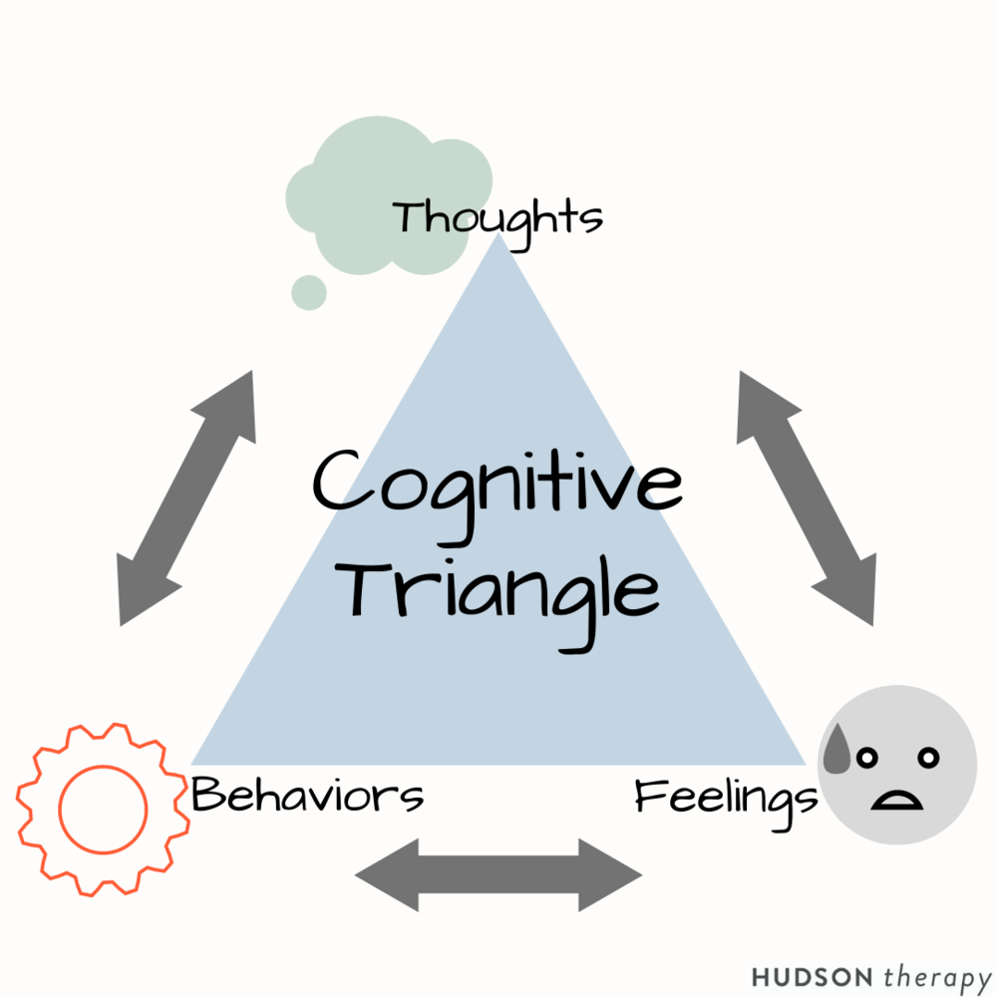
Cognitive restructuring
It is using techniques to help people be more aware, recognise and change their negative thinking patterns.
Individuals with ADHD tend to draw on maladaptive thinking.
It is a type of thinking that is generally false and not supported by much factual evidence.
Examples can include…
‘I always make mistakes’
‘I never do anything right’
‘Nobody likes me’
This thinking can then influence how you feel, and then how you act/behave.

Slide 7
Examples of Negative Thinking
Predicting the future (with a negative consequence)
Catastrophising
What if?
Jumping to conclusions
Taking things personally
Mind reading
Focus on the negative/ignoring the positive
Black and white or all or nothing thinking
Perfectionism
“Should”/“Shouldn’t”
Over Generalising

Slide 8
Questions to Ask About the Thought
What evidence have I got to say that it’s true?
What evidence have I got that says it may not be true?
How realistic is it?
If someone else were to tell me that this was their thought, what would I say to them?
What are the costs or benefits of thinking this way?
Is this thought helpful?
Can I see any negative thought patterns emerging?
How will I feel about this in 6 months time?
Is there another way of looking at this?

Slide 9
Example
“_____ Doesn’t like me, they never answer my calls”
The only evidence I have is that they’ve not answered twice. It’s during the day and they may be at work. They were fine with me a couple of weeks ago. If somebody else told me this I would tell them to wait until they get back to me- they might not be able to answer right now. Thinking this way isn’t helpful- it makes me worry all day.
Balancing Statement: “I have called ____ twice and they haven’t answered. They’re probably at work and will get back to me when they can”

Slide 10
Example
“I am utterly useless at everything”
I have made a mistake. I have made mistakes in the past. Most of the time I don’t make mistakes. I am good at some things. If someone else told me this I would tell them not to worry. This isn’t helpful, one mistake and I’m really down on myself. I don’t want to feel like this anymore. I can use this as something to learn from. Everybody makes mistakes
Balancing Statement: “I have made a mistake, this is unusual for me. I will put it right and learn from this.”

Slide 11
Coping strategies for emotional dysregulation

Slide 12
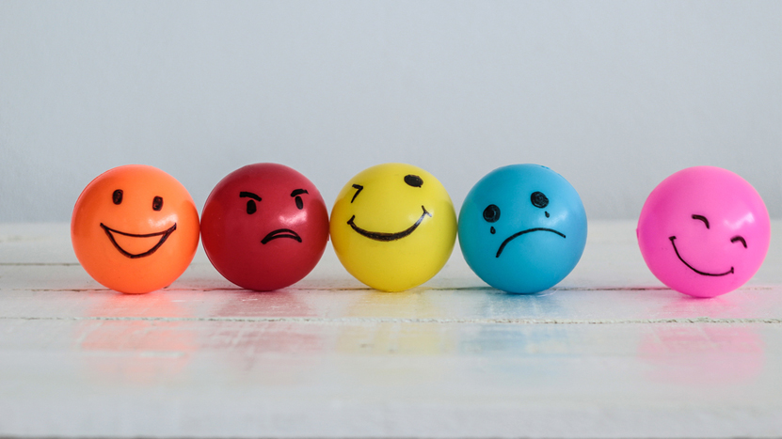
Emotional Dysregulation
Also known as mood lability
Sometimes called “mood swings”

Slide 13
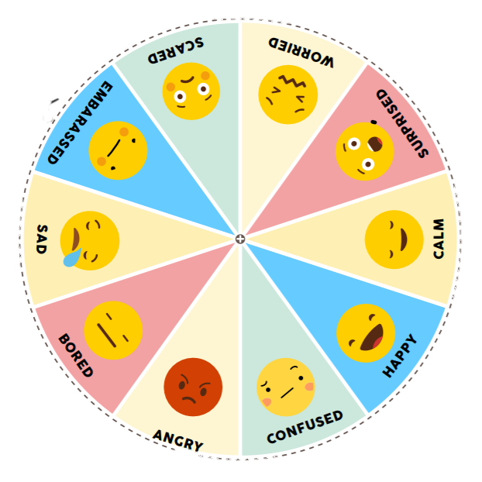
Emotional coping
People can feel:
Shame
Frustration
Guilt
Hopelessness
Relief
Embarrassment
What do you feel about your situation with ADHD?
Notes:
Often the emotions experienced by individuals with ADHD are conflicting, on one hand people can feel shame or frustration, and on the other hand people may feel relief due to finding out what their difficulties are and being provided with help to manage with their symptoms.
I would like you all to have a little think about what it is you might be feeling in response to your ADHD diagnosis or symptoms. I will give you a few minutes to have a think, it could be multiple emotions, it could be one emotion, it could be hard to put your finger on what exactly you are feeling.

Slide 15
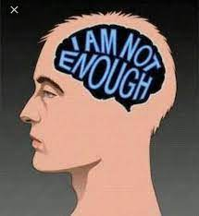
Self-esteem
Low self-esteem is also very common in individuals with ADHD.
Often, individuals with ADHD are treated as unintelligent, or given other negative labels.
People with ADHD are also more likely to experience more negative experiences, and have more negative beliefs about themselves.
Forgetfulness, low concentration spans, difficulty learning, all contribute to low self-esteem.
Notes:
Low self-esteem is very common in individuals with ADHD however, it is not applicable to everyone. It all depends on the beliefs you hold about yourself, and often, as ADHD can be a big part of someone’s life, it can be challenging not to let it affect you in a negative way depending on what experiences you have had with this.
As part of growing up and developing, we create and hold beliefs about ourselves that are formed by our experiences in the world. This could be for example, doing something nice for others, and holding the belief that I am a kind person – others may have you told you that you are kind also.
Often, when people have negative experiences as they are developing, this then can develop a negative belief about yourself, such as, I am not good enough. As ADHD develops very early on in life, the chances of individuals having more negative experiences because they have ADHD are higher. So, if people do not do very well in exams, may get shouted at a lot for forgetfulness or poor concentration, or treated as unintelligent because of the symptoms of ADHD, this can lead to a belief like ‘I’m not clever’ or ‘I can’t do anything’. This can then lead to low self-esteem.

Slide 16
Emotional Coping Strategies
Mindfulness – last week
Focusing on your strengths
ABC technique

Slide 17
Focusing on your strengths
When we put our attention on something a lot, it will be at the forefront of your mind.
If we are thinking about how we are ‘bad’ at this or that frequently, it can lead us to feeling bad about ourselves.
Instead try to focus on positive aspects of yourself.
Let’s take a few minutes to think about three strengths you have.
Notes:
This is what is known as ‘attentional bias’.
The more you focus on your good qualities, the more your self-esteem will start to improve.

Slide 18
Strengths
Notes:
I would like us to take a few minutes to think about as many of your strengths as possible, and think of some examples where you have shown these.

Slide 19
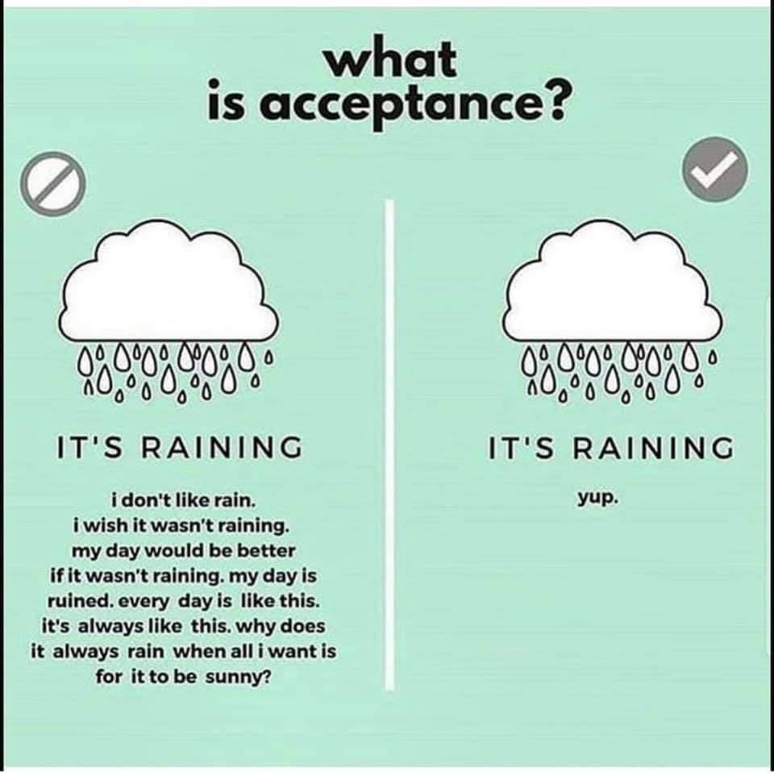
Accepting yourself
Self-acceptance is accepting all of ourselves, even the parts that we might not favour.
Accepting ourselves can be difficult.
This can be due to being taught we must live by certain standards or expectations over the lifetime.
We must stop trying to demonstrate our worth to others, or seek approval from others.

Slide 20
ABC technique
A: Accumulate positive experiences
B: Build mastery
C: Cope ahead of time

Slide 21
A: Accumulate positive experiences
This week, try to accumulate as many positive experiences as you can. This could be meditating, something you find fun, going for a walk or ringing a friend. List what you have done here. Count how many you have and try to beat it next week.

Slide 22
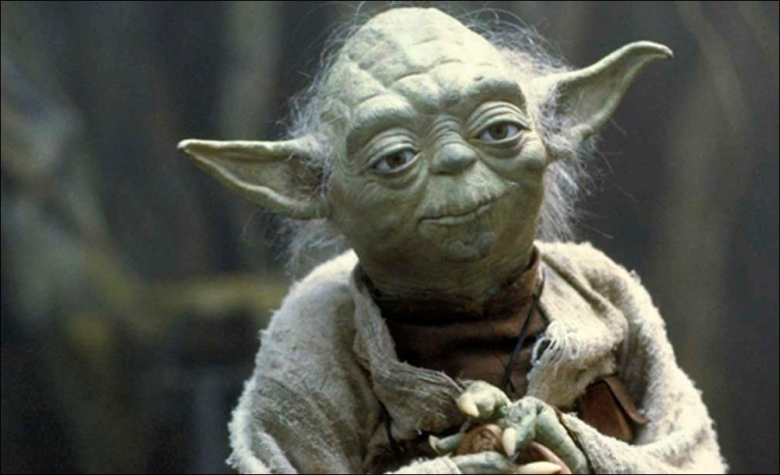
B: Build Mastery
Choose something you are going to master. This could be a craft skill, meditation/relaxation skills, managing anger or any aspect of self-care.
What is your chosen skill?
Plan how to master
Note how you’ve got on

Slide 23
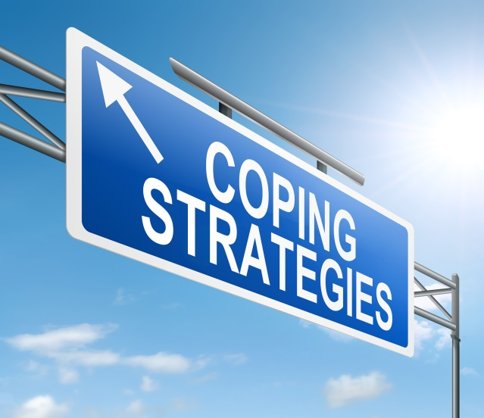
C: Cope Ahead of Time
Thinking about the week ahead, are there any situations that you are worried about?
What things could you do to plan ahead to make it easier to cope?
Create a plan

Slide 24
Prosocial interaction skills

Slide 25
Interacting with others
By accepting yourself, this can make interacting with others easier.
You may feel more able to share your difficulties.
You may feel more understood.
You may worry less about what others think.
You may be willing to try new ways of communicating.

Slide 26
Talking to others
Sometimes it is helpful to let people know what you might struggle with when interacting socially.
It could be that you may struggle to concentrate during a conversation. Putting out this ‘disclaimer’ can let others be aware and accommodate your needs.
For example, be mindful of the speed you are talking at; you don’t have to speak slowly but sometimes people do not realise they are talking quickly.

Slide 27
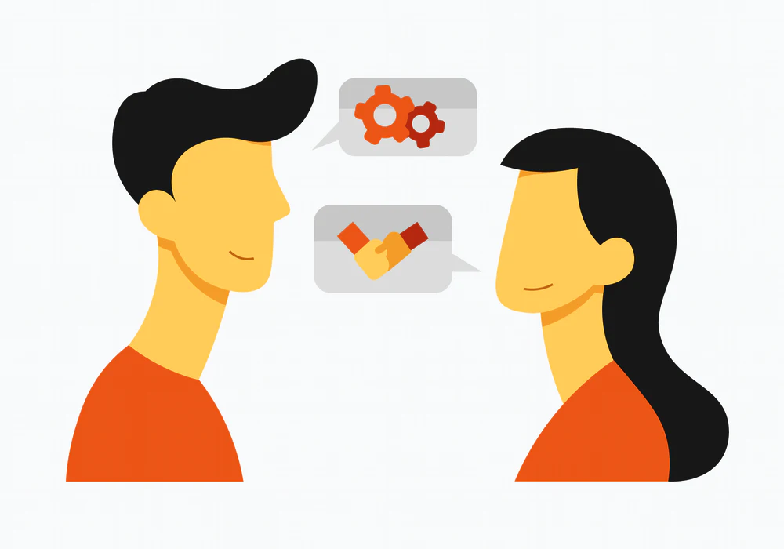
Pro-social interaction skills
When listening to others, people with ADHD may find it difficult to follow the conversation and be able to keep key points in your head to respond.
Self-awareness is very important.
Monitor if you think your awareness is faltering.
If it is, try and repeat important points that you hear in your head, pick out key pieces of information and disregard non-important information.
Notes:
Pro-social means…

Slide 28
Pro-social interaction skills
If you miss things in a conversation, it is okay, you can use the following social interaction skills to help you.
Clarification – Ask for more information or for someone to repeat themselves.
Probing questions – Ask questions to gain further information.
Paraphrasing – Allows the other party to make sure you heard correctly.
Summarising – Pulls together key points and concludes the topic.

Slide 29
Set time aside for relationships
It is common that the symptoms of ADHD can make an individual appear indifferent or uncaring in relationships, even when this is not the case.
Schedule in several short periods of time in the day for your relationships.
Quality over quantity.
Create reminders on your phone, calendar or other methods to help you remember big dates, e.g. anniversaries, birthdays etc.
Notes:
Often individuals with ADHD can have difficulties in their relationships, as the symptoms of ADHD can make interactions hard. The person may look like they are uninterested, appear indifferent or uncaring in relationships when often this is not the case. This can be due to how it is very difficult to not interrupt or sit still and listen to entire conversations, or even forgetting birthdays etc,.
It might be that individuals find it helpful to schedule in several short periods of time in the day for your relationships where you will just try your best to listen. This could be 5 minutes before and after you have had dinner for example. Set a timer on your phone and give that person your full attention for however long you can. It is important that the individual in the relationship is aware so that they can help you.

Slide 30
Takeaway from this session
Try to identify and understand your feelings.
Learn to accept yourself as a whole person, even the parts you might not favour.
Find out what your strengths are and look out for them in day-to-day activities.
If you feel comfortable, let others know what you might struggle with in interacting, as this can help you to develop your skills and increase understanding from others.

Slide 31
Mindfulness exercise

Slide 32
This is the end of Session 4. Thank you! Any questions?

Slide 33
adhd.webador.co.uk

