Slide 1
Organisation

Slide 2
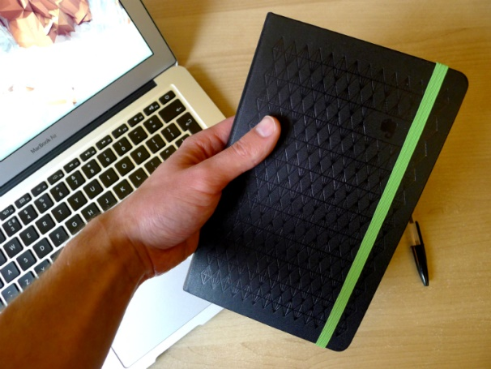
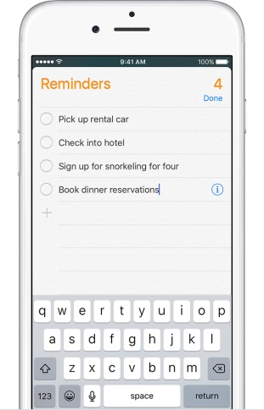
Organisational Tips
Keep a notebook handy to write down things you may need to remember
Create daily/weekly to do lists
Use a planner to note down what needs doing and when, appointments, work schedules etc
Have a calendar on the wall and mark off important dates/appointments
Set reminders on your phone
Declutter
Know where everything is- have a place for everything

Slide 3
Routine
It’s good to build a routine and stick to it as it helps you to remember things and plan your day
Make time for breaks
Before you go to bed, note down anything you think you’ll need to remember the following day
Have things ready for the morning the night before

Slide 4
Managing Workload
Make deadlines for tasks
Don’t procrastinate- do things straight away
Prioritise- what needs to be done first
Ask someone for help if you need to
Have everything needed for the task ready and know where it is
Labels and sticky notes can be useful

Slide 5
Useful tools
Planners/diaries
Mobile phone- alarms, reminders, notes, calendars
Calendars
Project books
Files for important paperwork
Notebook
To do list books
Boxes to put things in
Sticky notes
Desktop drawers to store small items
Notice boards

