Slide 1
ADHD “Attention Deficit Hyperactivity Disorder”
Psychoeducation and skills group

Slide 2
Group Rules
Cameras must be switched on.
Contributing to discussions and sharing your experiences is valued, but not obligatory.
If you would like to share some information please use the hand function available, start speaking or type in the chat box.
Please use appropriate language.
Please respect other views.

Slide 3
Overview of programme
Session 1: Introduction to ADHD
Session 2: Neurocognitive strategies (Part 1)
Session 3: Neurocognitive strategies (Part 2)
Session 4: Emotional regulation and social interaction skills

Slide 4
Session 2 contents Neurocognitive strategies (Part 1)
Strategies for inattention
Attentional control and reducing distractibility
Memory skills
Organising and planning skills
Mindfulness exercise

Slide 5
Increasing Attention Span

Slide 6
Inattention
This can look like…
Missing details and making careless mistakes.
Difficulty keeping attention in tasks or during leisure, poor concentration and easily distracted.
Forgetfulness and memory issues (paying bills, attending appointments, etc.).
Losing things often (phone, wallet, keys, etc.).
Appears to not be listening when spoken to directly.
Difficulty in following instructions or completing tasks.
Difficulty sticking to deadlines, organising tasks and activities.
Avoids tasks that require sustained mental effort.
Notes:
If we refer back to last week, these are some of the symptoms that can be seen in everyday life if you struggle with inattention.

Slide 7
Symptom of inattention
People with ADHD can experience difficultly in maintaining attention to things.
This might mean that a person with ADHD might find it hard to complete a task fully.
It might be that other tasks and distractions get in the way when trying to do something else.
This can lead to unhelpful coping strategies e.g. avoiding doing anything/procrastinating.
Notes:
By or use helpful ‘adaptive’ coping strategies when they are put in challenging situations.
Unhelpful coping strategies are formed as it is the way that your brain learns to respond in the most appropriate way possible, to overwhelming or stressful events. This is why we need to be aware of the unhelpful ways we can respond and teach ourselves new ways of coping.

Slide 8
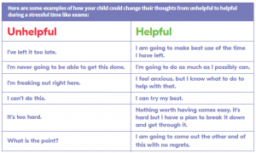
Unhelpful coping strategies used
Avoid or procrastinate doing tasks that you need to do.
Confrontation when interacting with people, instead of communication in a way that is helpful for everyone.
Impulsive behaviour as this does not require any thinking or processing of information.
Notes:
These are just some examples that you may or may not recognise in yourself that have developed to help you cope. However, they sometimes are not the most helpful way to cope and can get in the way of a good quality of life.

Slide 9
Strategies to help improve attention
Make sure you are not feeling tired.
What time are you most productive? Schedule the hardest tasks at this time.
Distractions in your environment – find the right balance for you (noise/quiet, how warm it is, is it dark/light, objects?).
Reduce or eliminate any ‘internal distractions’ (stress, hunger, etc.).
Notes:
If you are tired, it is more difficult to focus on a task you want to do. If you are tired, it might be easier to see if you could manage completing some easier tasks and save some of the more cognitively effortful tasks for days when you are feeling less tired.
Schedule important work for those hours when you feel most energised and attentive. Figure out what time of day are you most alert and schedule in the tasks that are harder to do, during this time when you have your full attention to complete tasks.
Distractions – what does the environment look like? You will need to figure out what distracts you in your environment, e.g. some people like complete quiet when trying to do a task, others prefer a little background noise, some people find it difficult to concentrate when there are many objects in a room so may need to go to a different environment, is it quiet/noisy, etc. A lot of this is trial and error for figuring out what works for you, adapting your environment to help your needs. Some individuals like a lot going on the background and others do not realise that this is causing their concentration to be difficult.
Internal distractions are things, such as, your feelings, stress, depression, or things such as hunger, which can make you feel distracted and unable to focus. It is important that you don’t try and do any tasks when you are having internal distractions.

Slide 10
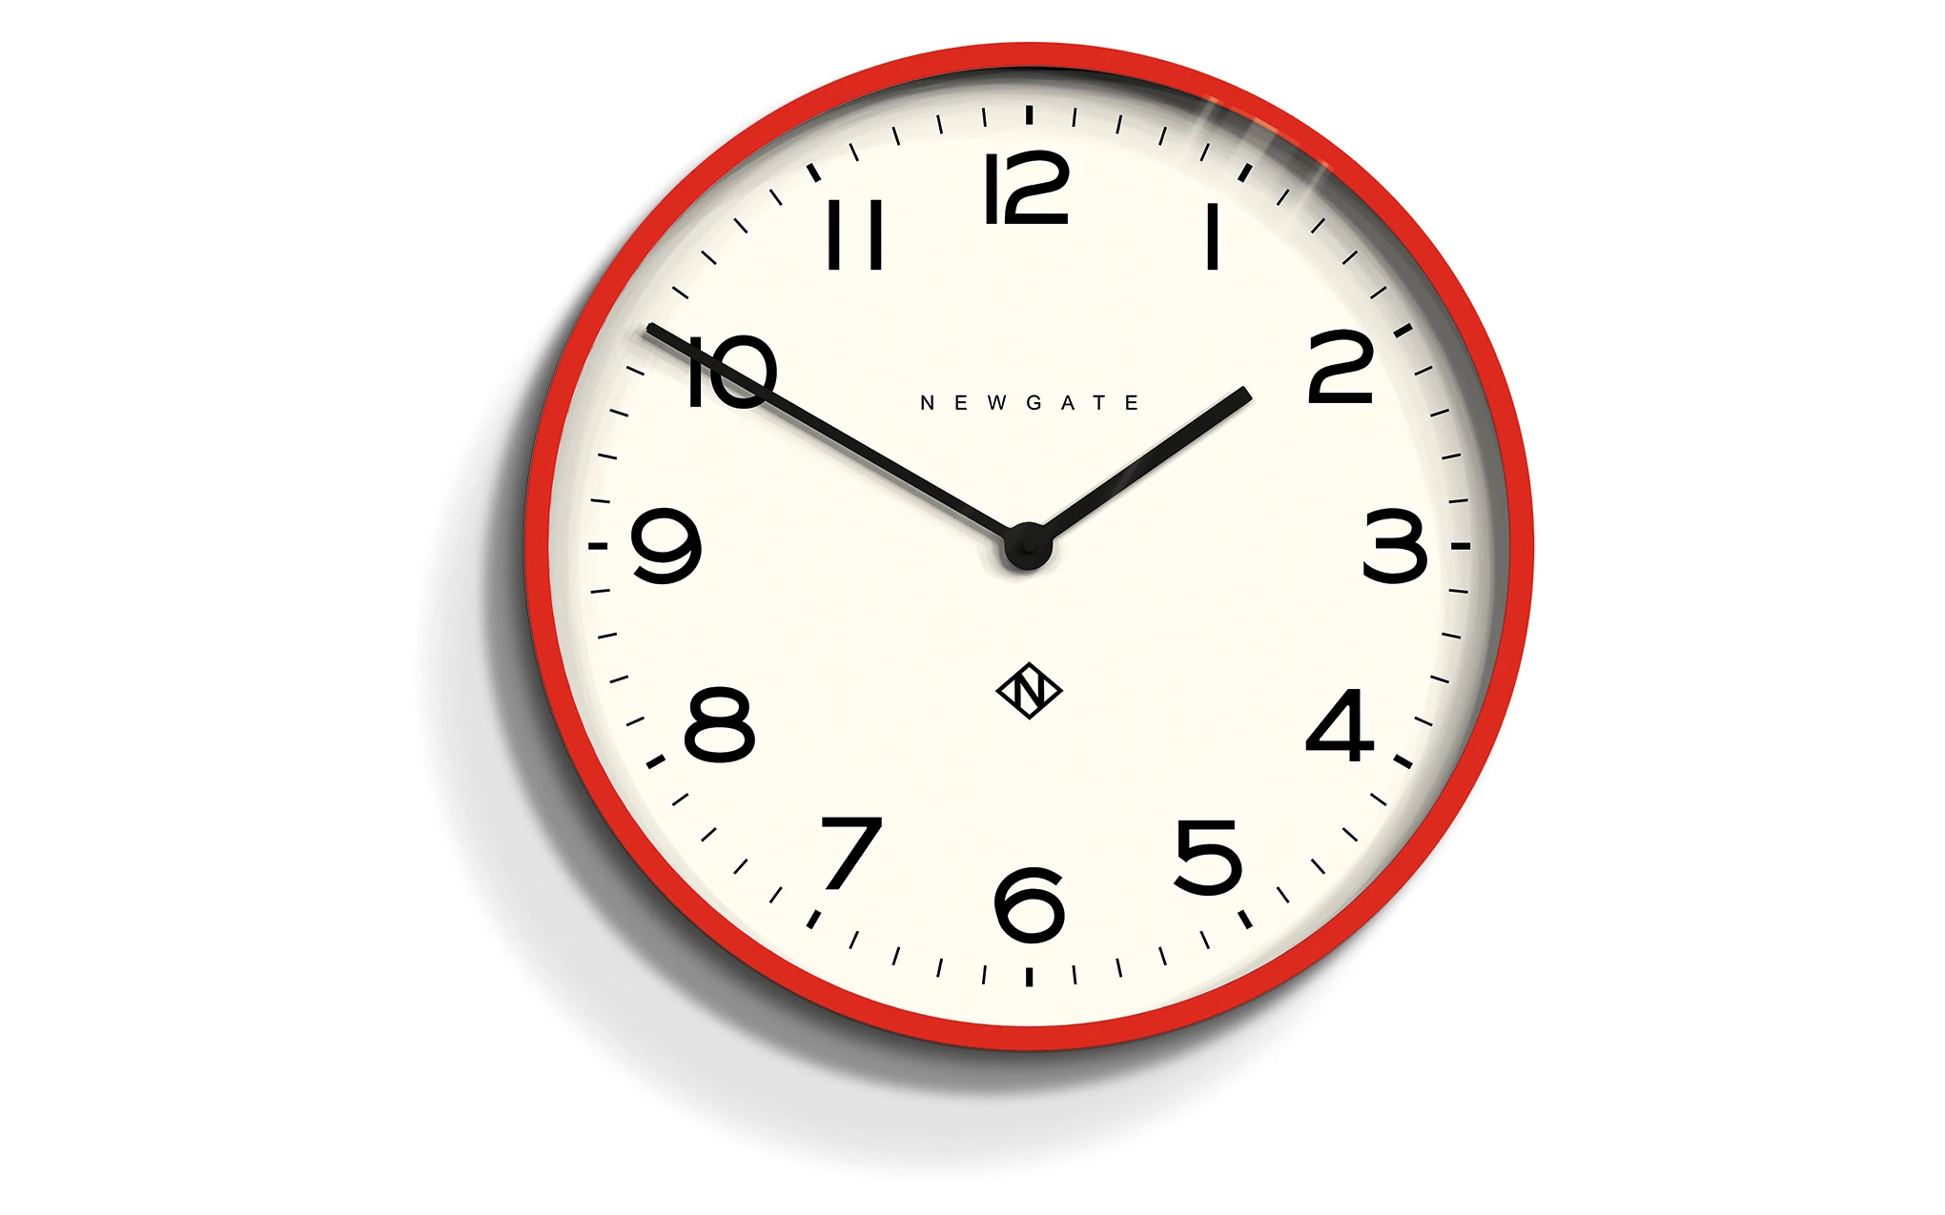
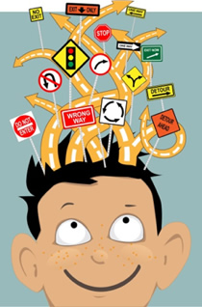
Strategies
Time the length of your attention span.
Create a distraction list.
If you are switching between tasks, it can be helpful to say out loud when you are switching a task.
Give yourself lots of time to complete a task, but put a time limit in place.
Notes:
By timing the length of your attention span whilst doing a relatively easy task, this will show how long you can naturally focus for. You know then to fit in tasks around this number. Then, in the future you can slowly try and build this up over time. For example, if you have a 10 minute attention span, set a timer for 10 minutes and focus on doing one thing for that 10 minute period. When the timer goes off, take a 5 minute break. Then you can repeat this for however many times you can manage and then stop. Each day, or every few days or even each week, increase the time spent focusing on doing one thing. E.g., it might be adding another 10 minutes onto your task, so that you are focusing for a period of 20 minutes and then take a 10 minute break.
Create a distraction list - When something ‘off-topic’ pops into your head, write it down/put it on a note straight away so that you can continue doing the task you were doing. By writing down distractions, you can then promise yourself after the task is done, you can look up or think about the distracting thoughts that came to you.
If you find it difficult to do one task at a time or to do more than one task at a time, it can be helpful to alternate between tasks that use different parts of the brain. Try and trick yourself into keeping interested. For example, you might want to clean your room, but can only manage 10 minutes at a time. Try cleaning your room for 10 minutes at a time, then try and read a chapter of an interesting book for 10 minutes. Keep alternating between these two tasks.

Slide 11
Strategies
Set regular timers on a device (phone) to keep your attention focused to one task.
Environmental associations: listening to a certain type of music, making a hot drink…
Try to complete some mindfulness each day.
Exercising/getting into nature.
Set yourself time when you have a REAL ‘brain break’, where you don’t put any pressure on yourself to complete tasks.
Notes:
A system in place could include setting regular alarms every 5 minutes for an hour to bring you back on track.
Environmental associations: do you prefer listening to a type of music when doing tasks? Do you make a drink? Making a little routine prior to completing a task can be helpful as it signals to the brain that it is time to start completing a task. Try and make your pre-task and during-task routine.
Mindfulness is very good for developing and strengthening your attention span. It helps to integrate all areas of your brain which over time, will lead to less distractions.
Completing exercise or getting into nature where there are green spaces has been proven to increase your concentration and attention levels afterwards.
Schedule in time where you have a REAL ‘brain break’. What this means is you need to give your brain a ‘proper’ break between doing tasks, either do something physical or completely different to what you have been doing, rather than doing something like checking your emails or scrolling through your phone. Even doing these mental activities (e.g. watching a youtube video) decrease your brain power instead of restoring it.

Slide 12
Improving Memory

Slide 13
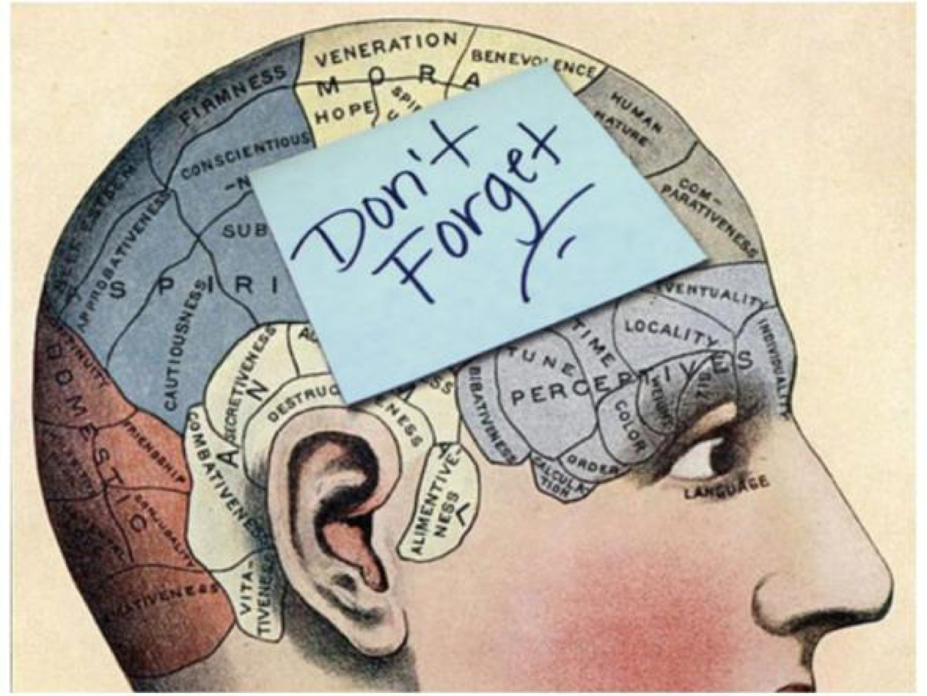
ADHD and memory
People with ADHD often find it more difficult to remember to do things, or learn new information.
Memory and attention go hand-in-hand.
Important to improve attention to help learning.
Memory difficulties can be very challenging to live with in daily life.
Notes:
If we recap a little from the prior session, the reason why memory and attention go hand-in-hand is how attention is one of the main components of memory, so any difficulties experienced maintaining attention, will also affect an individual’s memory ability.
It can mean that you are forgetting things often or misplacing your personal items. It can look like forgetting to pay bills, attending appointments, being oriented to dates and times.

Slide 14
Notes:
How memory works, we will use this situation of a box to explain why remembering things can be difficult for individuals with ADHD.
In order to put a piece of information in our memory, we must put our attention to what that information is. For example, putting an object inside a box, you will look at what object you are placing inside the box. This is the most important part of helping memory.
In order to be able to store information in our memory…

Slide 15
Working Memory
You use working memory every day to organise, plan, read, write, do mental arithmetic, follow a conversation, or follow multi-step instructions.
Working memory is when you are engaging in an activity, and also need to remember instructions whilst doing that activity.
Some people with ADHD struggle with their working memory.

Slide 16
Memory skills
Visualising things
Elaborate and repeat information
It is repeating this information that is very important to helping you remember information.
Putting things you need to remember with other bits of information that are similar will help you to remember them.
It is helpful to write these down.
Make sure you are getting enough sleep!
Notes:
Visualising things is another way for saying try to imagine what you need to remember in a more visual way in your brain. For example, it might be that… use example.

Slide 17
Memory skills
See if you have any problems with working memory by going to https://www.additudemag.com/working-memory-deficit-weak-short-term-memory-symptoms-test-adults/
Challenge yourself to remember a list of words and use chunking to categorise groups of words together
Try remembering something by making up a mnemonic or using one that already exists
It might be using sticky notes around the house and once you have completed the activity you throw the note away.
Creating a rhyme, a song or a joke to help you remember specific things.

Slide 18
Mnemonics
Memory techniques
Eg- Colours of the rainbow: Richard Of York Gave Battle In Vain
Can you think of any more?
30 days hath September, April, June and November- All the rest have 31, except February that has 28
North East South West- Never Eat Shredded Wheat
Notes on a stave: Every Good Boy Deserves Football

Slide 19
Organisation and planning

Slide 20
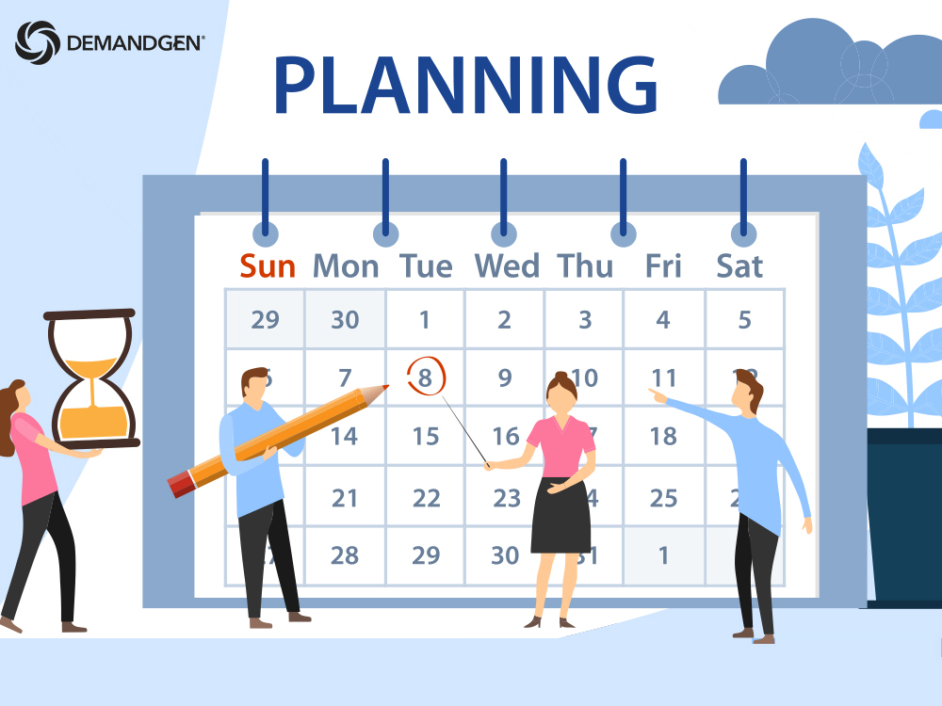
Organising and planning skills
Both improving attention and memory is helped by being more organised and being able to plan.
People with ADHD often find it difficult to plan and organise.
Mindfulness is one of those activities that can help strengthen the frontal lobe and make organising and planning easier.
Other strategies are also used to help people with ADHD to feel more able to plan and organise.
Notes:
The reason why often people with ADHD find it difficult to plan and organise is due to how one of the areas affected by ADHD is the frontal lobe, which is mostly responsible for planning/organising.
In our frontal lobe, we have a ‘built in’ planner, but sometimes it can be good to help our frontal lobe by providing it with a diary/calendar schedule.

Slide 21
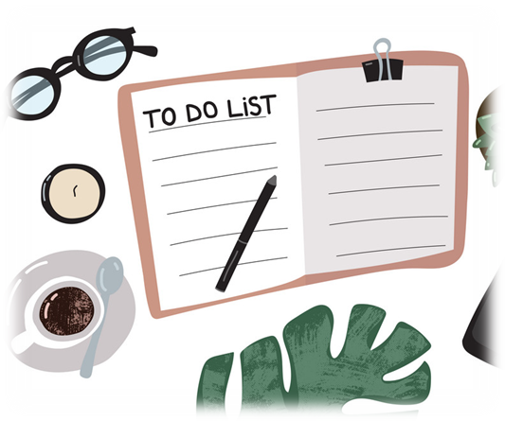
Organising and planning strategies
Make a new ‘To-Do’ list every day.
Write tasks in priority order
It is helpful to tick or cross off activities that are complete for a sense of achievement and satisfaction.
Set deadlines for when to have completed task by.
Use a daily planner/calendar and look at this throughout the day.
Notes:
The most important thing that individuals with ADHD must know is 1) what they need to do and 2) when they need to do it by.
The use of external aids is crucial to helping you with this.

Slide 22
Notes:
As you can see in this example priority task list, at the top you can write down three top priorities that you may need to do, in a short period of time.
Below this, there are secondary tasks, which are less important than the top priorities but that still need sorting at some point.
Below that, there is a notes section, which could be used for any random thoughts that may pop into your mind whilst writing your to-do list.
It is important when writing your top priorities down that you choose tasks that are very important you get done, either they are time sensitive or require larger amounts of effort.
The secondary tasks are things that you would like to get done, but it is not crucial if you don’t get round to them straight away.

Slide 23
Organising and planning strategies
Get reminders to be sent throughout the day (phone, electronic apps).
Creating a routine can make you more productive and feels less overwhelming doing tasks.
Habit formation: it take consistency to build a habit.
A habit at first is effortful, it takes ‘cognitive effort’ to start creating a habit.
Over time, your brain becomes used to this, it takes less ‘brain effort’ and you can build this up more.
If you start with a small habit it is easier to build up from this.
Notes:
For example, it might be that creating a full daily routine feels too overwhelming or too much, so it is perfectly acceptable if you want to just plan a morning or night routine, then gradually build this up. Initially, starting a routine to make it a habit takes a lot of ‘cognitive effort’. This means your brain has to actively think and be conscious when doing your newly implemented routine. However, what happens over time and consistently doing your new routine, is that your brain becomes used to this and your routine feels doable, meaning you have created a habit. A habit requires less effort cognitively, which means you have now got that mental energy to build upon what you have already, with more tasks in your day.

Slide 24
Creating a routine
Think about what your ideal day would look like?
Ideal time to wake up?
Ideal time to feel most motivated to do tasks?
Decide what needs to be in your daily routine by writing all the tasks down on a list that needs to be done every day.
This could include the smallest of activities, such as, wake up at 8am, make a hot drink, have a shower, etc.
Once you have created a list of the things you would like to achieve, it is important to put these factors in an order.
Notes:
Ideal day: where you are achieving things you want to achieve, fitting enough in that you are organised but not over planning.
Talk about habit formation and cognitive effort of habits.
Test out the routine. It can take up to 30 days to establish a new routine, so perseverance and consistency are very important. Have a look at how it feels and change it until it feels right.

Slide 25
Creating a routine continued…
Structuring/ordering your day
Think about when you work best and group tasks that are harder for those time periods. Put this into your routine.
Schedule in time for flexibility, and/or spontaneous activities.
Get specific
Write down the timings of when you want to do these things, be realistic!
Notes:
For example, someone finds doing household chores the most difficult. They are best motivated/energised during the evenings, so decide to do these difficult tasks during this time.

Slide 26
Notes:
This is an example worksheet of a template you could use for how you could structure your morning routine.

Slide 27
Wake up at 7am
Eat breakfast at 7:30am
Shower, dressed at 8am
Do errands at 9am -12pm
Lunch 12pm
Exercise 1-2pm
Chores and cook 2-6pm
Eat dinner at 6pm
Relax 6:30pm onwards
Night-time routine at 9pm
Notes:
A completed daily routine might look something like this, or something completely different to this, it is completely up to you with what you want to achieve and your goals. It is also important not to over-estimate your abilities initially, build it slowly. You can break this down more if you need to, this is just an example.
It is important that once you have created this, to try your best to stick with it. Even if you miss a certain time slot, don’t give up, just do that activity for a smaller amount of time.

Slide 28
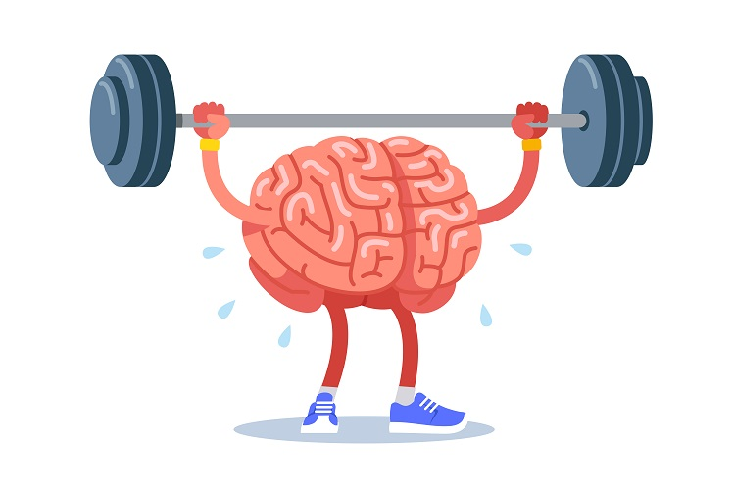

Slide 29
Takeaway from this session
Create your pre-task routine to help your mind to focus.
Time your attention span, and figure out how much to increase it by gradually. Try your best to stick with it.
Sort out your environment to complete tasks.
Create a routine and adjust if need be.
Write down on paper/write an electronic note any time you get a distracting thought whilst doing something.
Practice an activity of mindfulness each day.

Slide 30
Mindfulness exercise
Grounding your attention using your senses.
5 – things you can see
4 – things you can touch
3 – things you can hear
2 – things you can smell
1 – thing you can taste

Slide 31
This is the end of Session 2. Thank you! Any questions?

Slide 32
adhd.webador.co.uk

