Slide 1
ADHD “Attention Deficit Hyperactivity Disorder”
Psychoeducation and skills group

Slide 2
Group Rules
Cameras must be switched on.
Contributing to discussions and sharing your experiences is valued, but not obligatory.
If you would like to share some information please use the hand function available, and type in the chat box.
Please use appropriate language.
Please respect other views.

Slide 3
Overview of programme
Session 1: Introduction to ADHD
Session 2: Neurocognitive strategies (Part 1)
Session 3: Neurocognitive strategies (Part 2)
Session 4: Emotional regulation and social interaction skills

Slide 4
Session 3 contents Neurocognitive strategies (Part 2)
Strategies for hyperactivity and impulsivity
Impulse control skills
Problem-solving skills
Hyperactivity skills
Mindfulness exercise

Slide 5
Strategies for Impulsivity

Slide 6
Impulsivity
Impulsivity is a tendency to act on an impulse without thinking, reflection or consideration for consequences.
This can look like…
Intruding into or taking over what others are doing.
Acting quickly without thinking.
Difficulty in waiting for his/her turn during social interaction.
Notes:
An example of impulsive behaviour includes spending too much money.

Slide 7
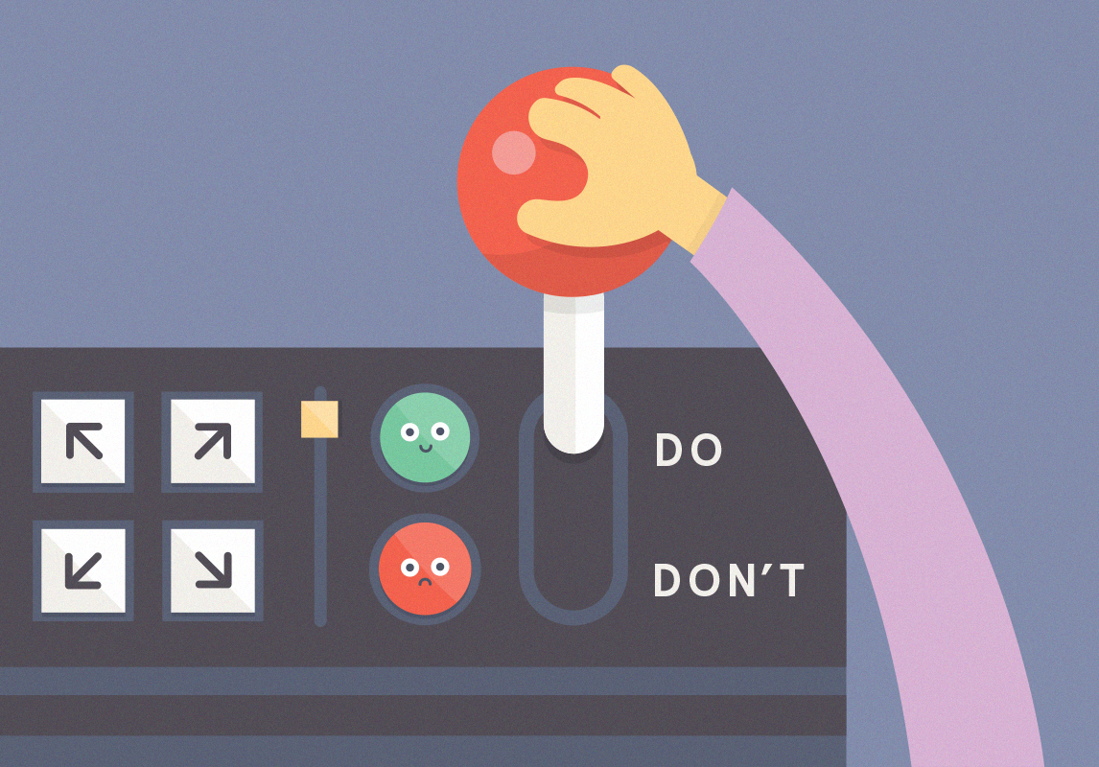
Symptom of Impulsivity
People with ADHD are often unable to interpret their thoughts and behaviours in a way that makes sense to them, when they are in a stressful situation.
Impulsivity may mean they respond to events quickly and spontaneously.
It is NOT a lack of understanding about consequences.
Individuals with ADHD can be impulsive in thoughts, emotions, and actions, making concentration and focus extremely difficult.
It can present to others as looking aggressive, becoming defensive or ‘not thinking’.

Slide 8
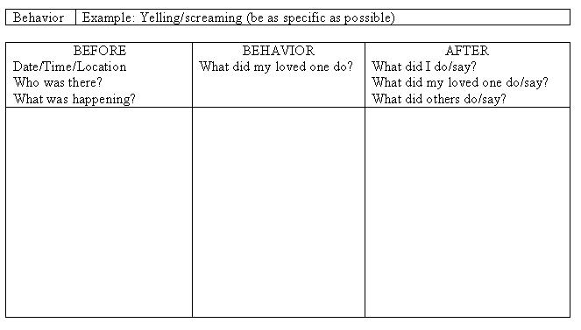
Strategies for impulsivity
Identify what impulsive behaviours you do that you may want to change?
Identify when are you in these situations where these behaviours might happen?
What triggers this impulsive behaviour?
3
1
2
Notes:
For example, “I am in debt as I spend too much money”. The impulsive behaviour is buying items.
In what situation may this happen? Is it when you are feeling certain emotions? Is it when someone says something to you, or the beliefs you hold about yourself?
Outline behavioural hopes and expectations – if you were not impulsive in this situation, what would your behaviour be? It is important to create a pretend scenario in your head where you might be impulsive, so for example, you were sad and started to impulsively buy things, and instead imagine how that scenario would play out in your mind without the impulsivity. For example, I need to recognise when I am sad, so I will take care of myself, maybe I will talk to my support system instead of turning to buying things.
Some individuals find it helpful to imagine what their life would look like without their impulsive behaviours.
Creating a routine helps to reduce impulsivity as it creates less free time to be impulsive.
Multitasking. This may sound counterintuitive at first, as you might think that if you’re supposed to be concentrating on one thing at a time, surely multitasking would make you more impulsive? Actually, research shows how multitasking can be good for adults with ADHD, as if you are focusing on a task, but holding back an impulse to do something else, you’re activating the inhibitory network in your brain. Multitasking, because you’re focusing on multiple tasks, can strengthen this network and help you develop impulse control (Bank, 2015).
Sometimes exercising when you feel like you want to be impulsive can help focus the mind.
It is important to remember that not all impulsivity will be able to be controlled, it is about accepting and being kind to yourself and keep trying.

Slide 9
Strategies for impulsivity
Outline behavioural hopes/expectations
What would your life look like if impulsivity is not a big problem?
Create routine
Multitask
Problem-solve

Slide 10
Problem Solving Cycle
Define the problem
Generate alternatives
Evaluate and select alternatives
Implement the solution
Evaluate the solution

Slide 11
1. Define the Problem
Identify any problems you may have at home, work, college etc. This could include:
Fidgeting/restlessness
Getting up when you are expected to remain seated
Doing things without thinking things through or without considering consequences
Problems with frustration
Not being able to wait for something

Slide 12
2. Generate Alternatives
Think of all possible solutions to the problem, good or bad, and write them down: e.g. For fidgeting/restlessness…
Consider using a wobble chair/wobble cushion/a standing desk
You could use a focus aid such as a stress ball or koosh ball
You could set time intervals where you can take a short break or walk around a bit
You could try breathing techniques
You could use a mind map or write all your ideas down

Slide 13
3. Rank solutions in preference order
Is it realistic?
Do I have the resources to do this?
What do I know about or not know about? Do I need to learn more?
Have I explored everything?
Which seems most doable?
Remember that you can gradually build up to doing things
Is one solution sufficient or do I need to use more than one?

Slide 14
4. Implement the Solutions
Try it out

Slide 15
5. Evaluate
Did the solution work?
Has the problem been solved/managed? If no, go through the cycle again
Have any other problems become apparent? If yes, go through the cycle again

Slide 16
Strategies for Hyperactivity

Slide 17
Hyperactivity
Hyperactivity is a state of excess activity, with abnormal or extreme levels of activity.
This can look like…
Difficulty in sitting still or fidgeting with hands and feet.
Gets and stands up during situations where must be seated.
Feels as though has excessive energy, displays restlessness or feels impatient.
Being talkative and often interrupts conversations.
Notes:
If we recap from a few sessions ago, hyperactivity is the symptom whereby a person is in a state of excess activity, with abnormal or extreme levels of activity.

Slide 18
Symptom of hyperactivity
Individuals with ADHD can struggle with hyperactivity.
This can look like people being constantly ‘on edge’, or presenting with a chaotic lifestyle.
People will often feel like they cannot ‘settle’.
This can affect someone’s quality of life negatively and create exhaustion.

Slide 19
Strategies for hyperactivity
Exercise
Avoiding caffeine at all/late in the day or consuming other stimulating foods/drinks
The TIP skill
Tip cold water on your face
Intense exercise for 20 minutes
Paced and guided breathing exercises
Mindfulness
Notes:
What the benefits of mindfulness?

Slide 20
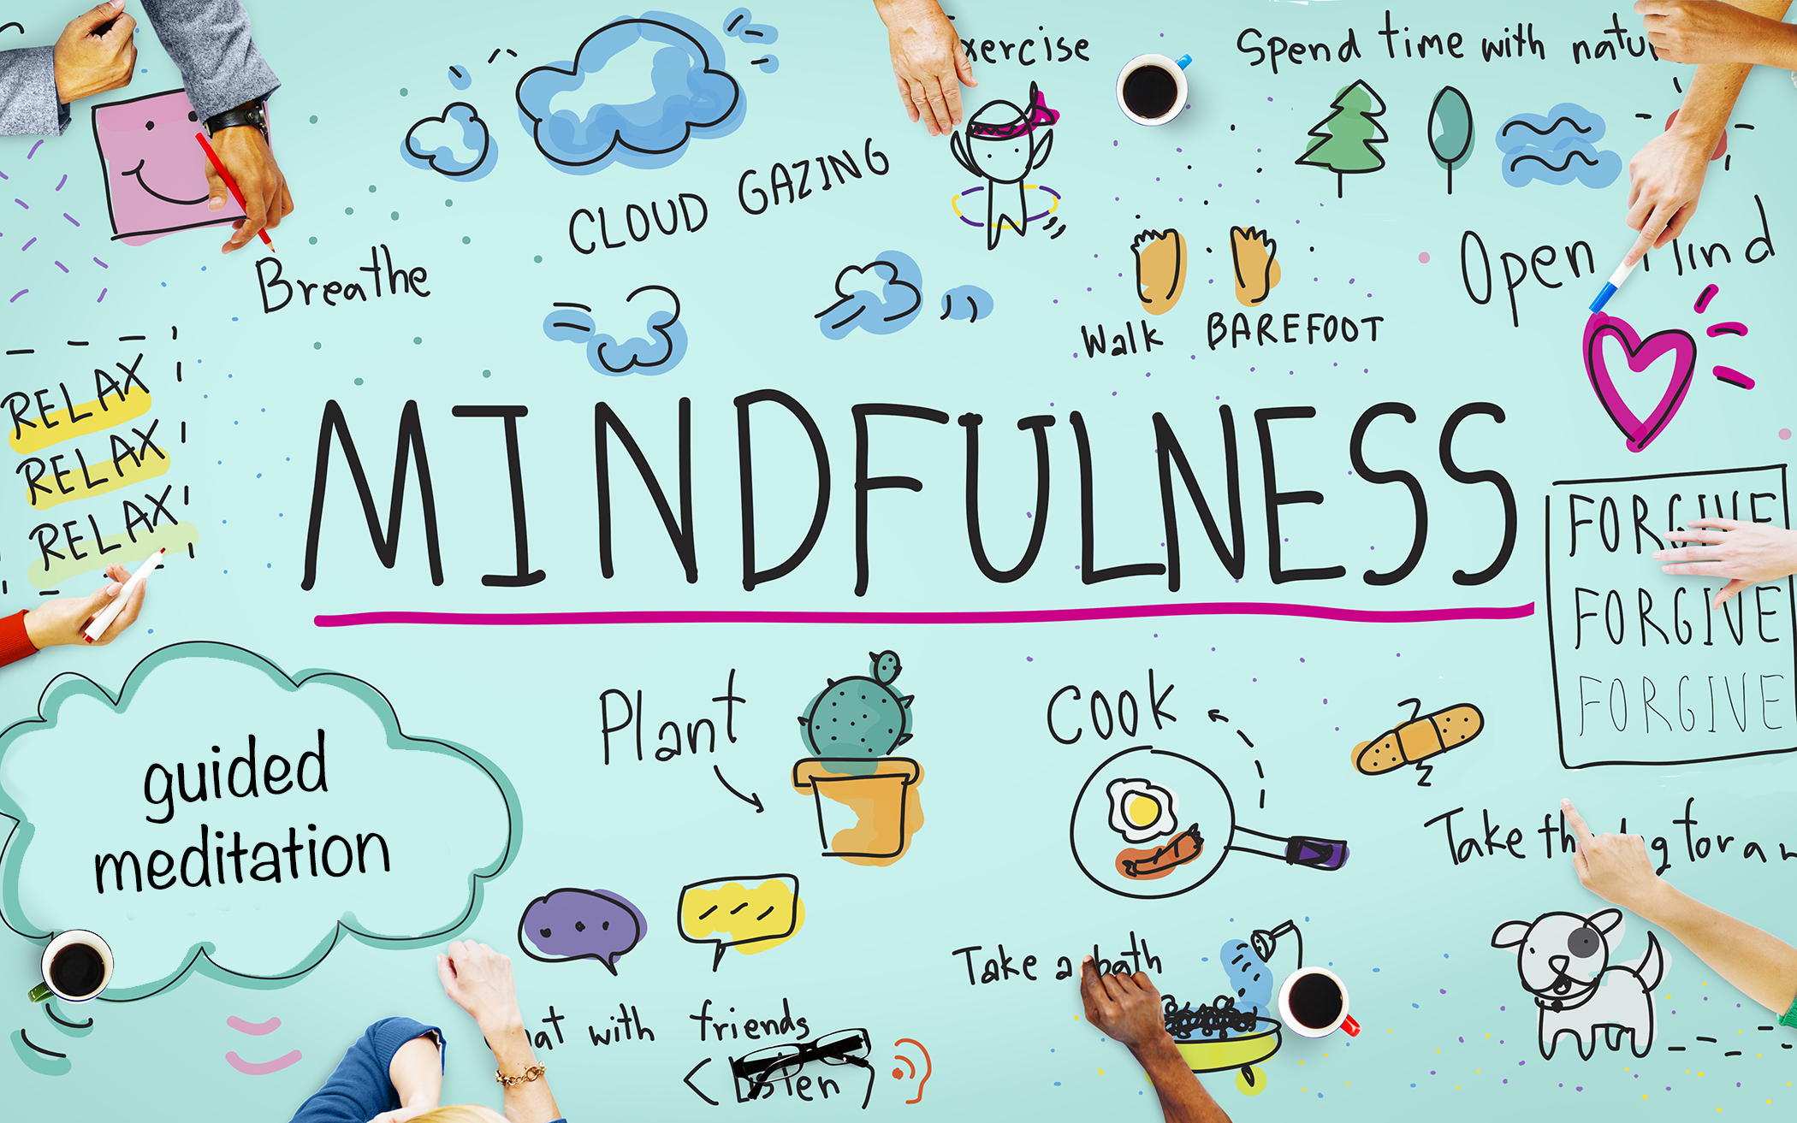
Mindfulness
Mindfulness is the activity of being aware of one’s present moment.
Common examples include:
Breathing
Meditation
Other examples include:
Yoga
Cooking
Gardening
It is any activity where you are fully engrossed in the activity.
Notes:
You may have noticed that we have completed a mindfulness exercise at the end of the last session and we will complete a mindfulness session
It’s okay for your mind to drift away when doing any mindfulness activity. Just gently bring yourself back to the task at hand. It will become easier the more you practice, as it is a skill that is built.

Slide 21
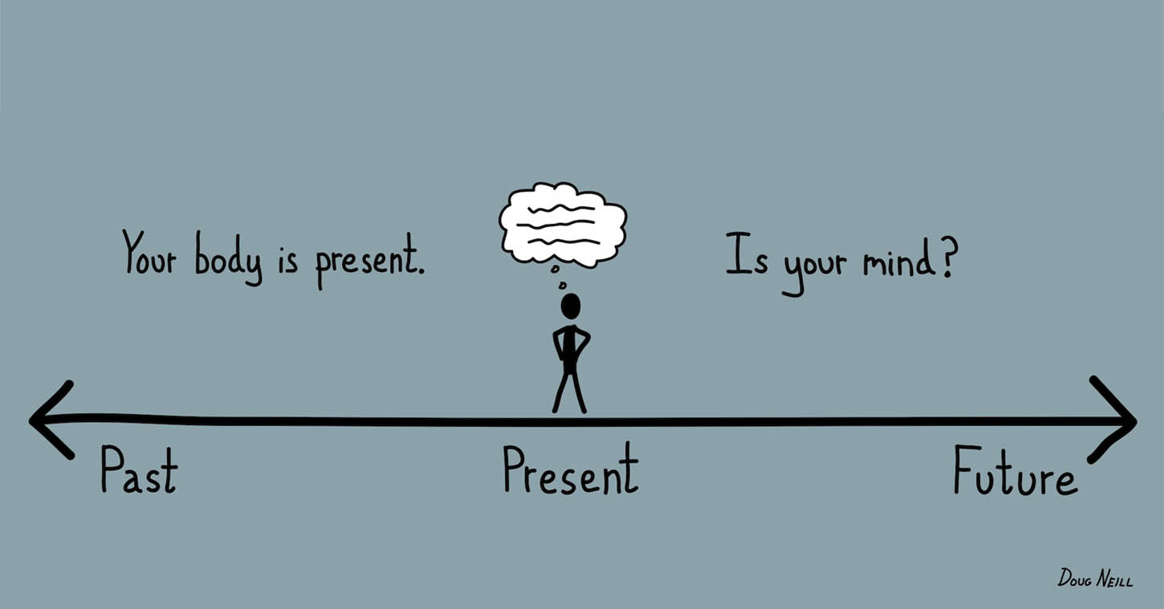
Mindfulness
Mindfulness helps to connect all areas of your brain (brain integration).
In the brains of individuals with ADHD, connection with all different parts of the brain is more difficult.
Mindfulness helps people feel more able to not react impulsively, and become less emotionally reactive in situations.
This is why mindfulness is especially helpful for individuals with ADHD.
Notes:
Because ADHD individuals have more difficulty with connecting all different areas of the brain, this is why we can see the symptoms that we have discussed so far, impulsivity, hyperactivity and inattention.

Slide 22
Takeaway from this session
Identify what your impulsive behaviours might be and when they are more likely to happen.
Think of what you want or expect to happen in these situations instead.
When you feel as though you might have excess energy, utilise the strategies we have spoken about, including mindfulness.
Practice an activity of mindfulness each day.
Complete a problem-solving activity, whereby you think of a problem you have, generate solutions, rate these solutions and pick the one that you think is the best.

Slide 23
Mindfulness exercise

Slide 24
This is the end of Session 3. Thank you! Any questions?

Slide 25
adhd.webador.co.uk

