Slide 1
ADHD “Attention Deficit Hyperactivity Disorder”
Developed by Cieva Boyle and Emma Leivesley

Slide 2
Overview of programme
Session 1: Introduction to ADHD
Session 2: Neurocognitive strategies (Part 1)
Session 3: Neurocognitive strategies (Part 2)
Session 4: Emotional regulation and social interaction skills

Slide 3
Group Rules
Cameras must be switched on.
Contributing to discussions and sharing your experiences is valued, but not obligatory.
If you would like to share some information please use the hand function available, or type in the chat box.
Please use appropriate language.
Please respect other views.
What’s said in ADHD group stays in ADHD group

Slide 4
Understanding ADHD

Slide 5
Aims of Presentation
Understanding what ADHD is (diagnosis and symptoms)
Development and effects of ADHD
Treatment and management for ADHD
Identify individual difficulties
SMART goals
Mindfulness exercise

Slide 6
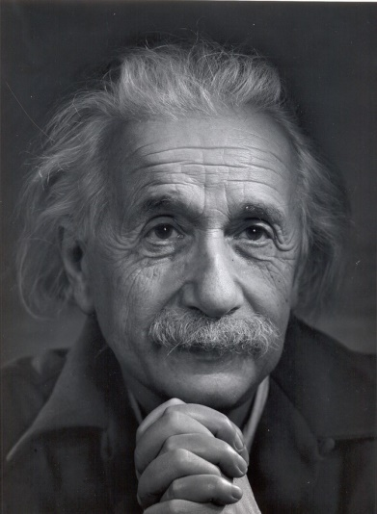
ADHD
Famous people with ADHD:
Jim Carrey- Actor
Emma Watson- Actress
Will Smith- Actor/musician
Michael Phelps- Olympic swimmer
Whoopi Goldberg- Actress
Jamie Oliver- TV chef and business owner
Michelle Rodrigues- Actress
Justin Timberlake- Musician
Albert Einstein- Scientist

Slide 7
What is ADHD?
It’s a common neurodevelopmental disorder
Symptoms start during childhood and it can persist into adulthood
It can cause impairment in functioning and carrying out day to day task
It is often confused with other disorders meaning late diagnosis
Everyone with ADHD is different
ADHD is a valid diagnosis
It is a treatable condition
Worldwide around 5% of children have ADHD and 2.5% of adults have ADHD

Slide 8
Diagnosis and the Different Types
DSM-V Criteria:
A: 5 or more symptoms of inattention or hyperactivity-impulsivity
B: Several symptoms present by the age of 12 (possible for late onset)
C: Several symptoms present in 2 or more settings (eg school, home, work)
D: Several symptoms interfere with or reduce quality of functioning socially, in education or work
E: Symptoms are not better explained by another condition (eg. depression)

Slide 9
Diagnosis and the Different Types
A diagnosis of ADHD involves observing three symptoms that people may experience:
Inattention
Hyperactivity
Impulsivity
ADHD symptoms are divided into 3 categories
Children need 6 or more symptoms for a diagnosis where adults only need 5 as symptoms reduce or are masked in adulthood

Slide 10
Diagnosis and the Different Types
Subtypes:
Predominantly inattentive
Predominantly hyperactive-impulsive
Combined

Slide 11
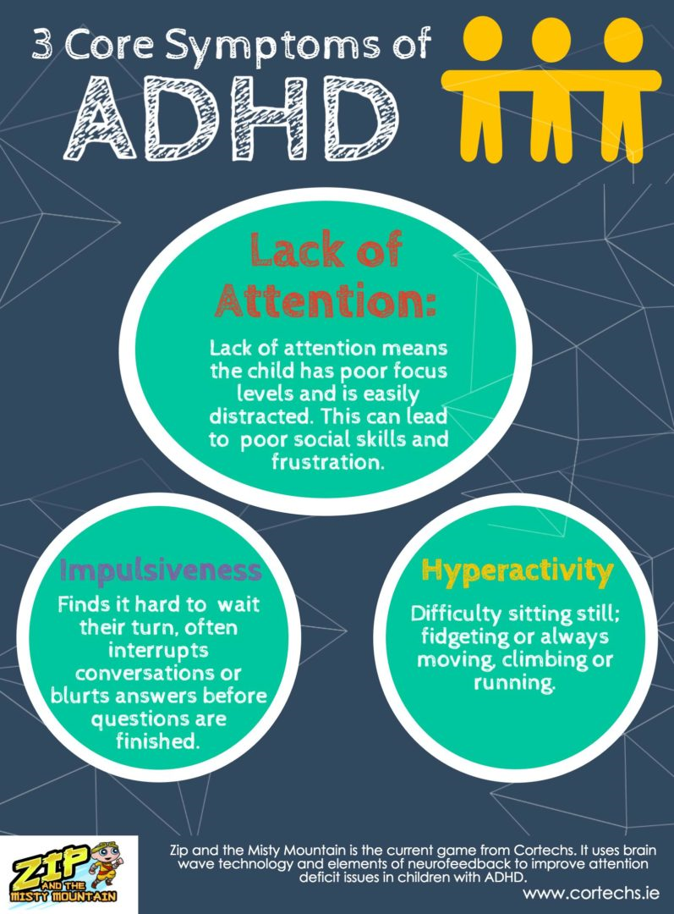
Understanding ADHD diagnosis
ADHD is diagnosed when there is a constant pattern of symptoms, which interferes with your daily functioning or development.
ADHD symptoms make daily life substantially more difficult and/or causes distress in one or more area of your life; socially, academically or occupationally.
Notes:
An important part of making a diagnosis is the observation that ADHD symptoms make daily life substantially more difficult and/or causes distress in one or more area of your life; socially, academically or occupationally.

Slide 12
Coping with a diagnosis
People can experience mixed feelings if they receive a diagnosis of ADHD.
Some can feel relief at having an explanation and access to help.
Others feel a sense of shame, frustration and stigma.
Individuals often fluctuate in their response to being provided with a diagnosis.
Notes:
These mixed feelings can depend on how long they have experienced symptoms, or the reactions they have received from others.
Some individuals have experienced difficulties associated to ADHD for long periods of time, so can experience relief when they feel if they have an explanation.
Others feel a sense of shame, frustration and stigma.

Slide 13
Diagnosis and the Different Types
Inattention Symptoms:
Lack of attention to detail, makes careless mistakes
Difficulty sustaining attention
Doesn’t listen when spoken to directly
Trouble finishing or completing tasks
Problems organising tasks and activities
Avoids, dislikes or is reluctant to do tasks that involve sustained mental effort
Loses and misplaces things
Easily distracted
Forgetful in daily activities

Slide 14
Diagnosis and the Different Types
Hyperactivity Symptoms:
Often fidgets with or taps hands or feet or squirms in seat
Often leaves seat when remaining seated is expected
In children running about and being restless- in adulthood being restless or overactive
Difficulty engaging in leisure activities quietly
Always “on the go” as if “driven by a motor”
Talks excessively
Impulsivity Symptoms:
Blurts out an answer before questions have been completed
Difficulty waiting or taking turns
Often interrupts or intrudes when they’re working or busy

Slide 15
Gender Differences
In childhood, more males are diagnosed than females
This evens out in adulthood
Females are less likely to be diagnosed in both childhood and adulthood as:
Boys/men have more disruptive/externalising behaviour
Girls/women are more likely to compensate with prosocial skills

Slide 16
Problems in Daily Life
Inattention Related Problems | Hyperactivity Related Problems | Impulsivity Related Problems
Disorganisation and inefficiency Procrastination Failure to plan ahead Forgetfulness Difficult in multi-tasking Misjudging how long it takes to perform tasks Inability to complete tasks Distractibility Poor ability to follow long explanations Ceaseless mental activity- mind wandering | Inability to relax Restless sleep Excessively active lifestyle Constant purposeless motion of feet and hands Constantly talking too much Constant stimulus seeking behaviour | Disinhibited behaviour May be linked to substance misuse- alcohol, cannabis, cocaine, tobacco, caffeine May be linked to overeating Maybe linked to aggressive behaviour or violence Speaking out or making decisions without considering others Impatient and unable to wait in queues

Slide 17
How can ADHD affect your daily life?
Academic difficulties are common.
Difficulty in handling large workloads, disorganisation, difficulty in following instructions, etc.

Slide 18
Experience problems with social relationships.
Easily irritated by what others are doing/saying, impulsive talking, losing temper with others, etc.

Slide 19
Occupational difficulties.
Difficulties in organising and completing work tasks, difficulty prioritising, issues with authority, distractibility, etc.

Slide 20
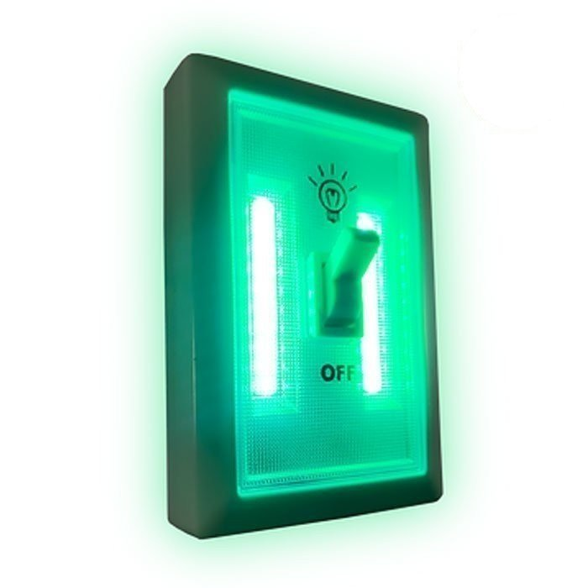
What’s happening in the brain?
The default mode of our brain is when our minds wander. When we need to pay attention to something, the default mode network in the brain is deactivated- In ADHD this often remains switched on, not turned off completely or turned off more slowly
Delayed development of brain areas that are associated with executive functioning (planning, attention and working memory) and emotion regulation
Notes:
Executive functioning also includes organising, prioritising and initiating work; focussing, sustaining and shifting attention to tasks; regulating alertness, sustaining effort and processing; managing frustration and regulating emotions; monitoring and self-regulation of activities, utilising working memory and accessing recall (remembering). Working memory allows us to remember things for long enough to allow us to carry out tasks.

Slide 21
ADHD across the lifespan
Pre-School | School age | Adolescent | College Age | Adult
Behavioural disturbance | Behavioural disturbance Academic Impairment Some difficulty in social interaction often tolerated by peers | Not fulfilling exam potential Increasing lack of acceptability and tolerance by peers Lower self-esteem Smoking, alcohol and drugs Antisocial behaviour | Academic failure Not coping with daily tasks Occupational difficulties Low self-esteem Alcohol and substance misuse Injury and accidents | Mood instability Low self-esteem Relationship problems Difficulty organising, planning and completing projects Motor accidents Alcohol and substance misuse Parenting style may be affected

Slide 22
Comorbidity
This means having more than one diagnosis at a time
In ADHD it is common to have a diagnosis of
insomnia
anxiety
depression
personality disorders
alcohol misuse
substance misuse
learning disability
obesity
autism

Slide 23
Treatment and Management of ADHD
Psychoeducation
Counselling or CBT based intervention
Coaching
Mindfulness
Medication:
Stimulants: Lisdexamfetamine, Methylphenidate, Dexamfetamine
SNRI (Selective Noradrenaline Reuptake Inhibitor): Atomoxetine
If taking medication, try and take it in the morning so it works during the day.

Slide 25
Identifying individual difficulties
ADHD symptoms vary a lot from person to person, so it is important to identify your own difficulties.
What are the difficulties that you experience?
Try and think of three things and write these down to have as goals.
Notes:
What will be important before going forwards is to identify what your specific needs are and any improvements you are hoping to make.

Slide 26
Example ‘SMART goal’ “Be more organised”
SPECIFIC – what does this mean to you specifically? Remember to start small.
E.g. “I will create a morning routine made up of three tasks I need to do”.
MEASURABLE – the goal needs a quantity to measure it by (is it to be done daily, per week?, etc.)
E.g. “I will aim to complete this morning routine once each week”.
ACHIEVABLE – can you achieve this? If not do not worry, start smaller.
E.g. “I feel able to complete this once per week until I build this up gradually to two times per week”.
REALISTIC – Is this goal realistic for you at this moment?
E.g. “ This is realistic as more than once a week for me is too much right now”.
TIMELY – The goal must be achieved within a certain time frame to know if it is successful.
E.g. “I will see how easy I find completing my morning routine once per week in one month’s time to see my progress. If I feel able, I will aim to complete this morning routine two times per week”.

Slide 27
Takeaway from this session
Think of up to 3 general goals you would like to start working on during/after this program.
These goals could be related to how you feel, improving your skills or improving your relationships, is it entirely up to you.
Then turn your general goals into SMART goals, using the resources on the prior slide.

Slide 28
This is the end of Session 1. Thank you! Any questions?

Slide 29
Website for resources:
adhd.webador.co.uk

